Slide 1
Variables and Data types in Java
Presented by S.R.Zameer

Slide 2
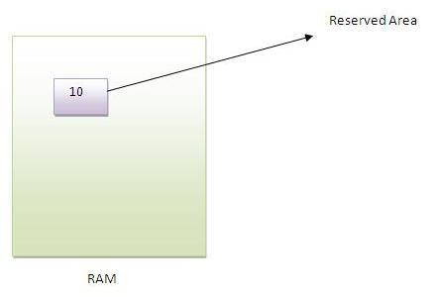
Variable
Variable is a location to store values in the RAM.

Slide 3
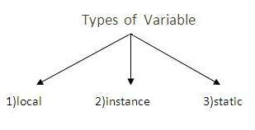
Types of Variable
There are three types of variables in java
local variable
instance variable
static variable

Slide 4
Local Variable
A variable that is declared inside the method is called local variable.

Slide 5
Instance Variable
A variable that is declared inside the class but outside the method is called instance variable. It is not declared as static.

Slide 6
Static variable
A variable that is declared as static is called static variable. It cannot be local.
We will have detailed learning of these variables in next chapters.

Slide 7
Data Types in Java
In java, there are two types of data types
primitive data types
non-primitive data types

Slide 8
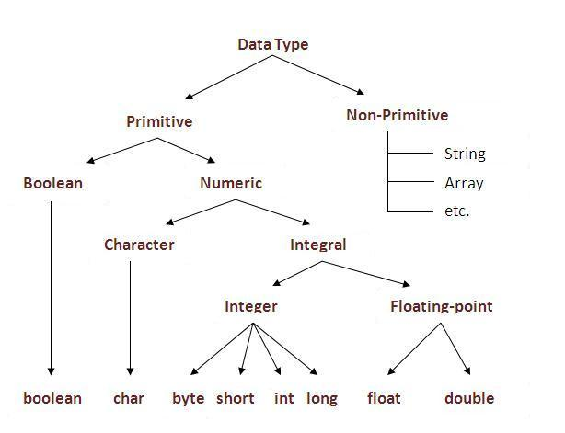
Data types

Slide 9
Data Types
Data Type | Default size | Range
boolean | 1 bit | (True or False)
char | 2 byte | Nil
byte | 1 byte | -128 to 127
short | 2 bytes | -32768 to 32767
int | 4 bytes | -2147483648 to 2147483647
long | 8 bytes | -9223372036854775808 to 9223372036854775807
float | 4 bytes | 3.4e-38 to 3.4e+038
double | 8 bytes | 1.7e-308 to 1.7e+308

